Slide 2
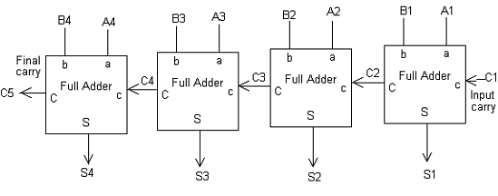
Parallel Adder: Ripple Carry Adder (Carry Look-ahead adders also is parallel adder)

Slide 3
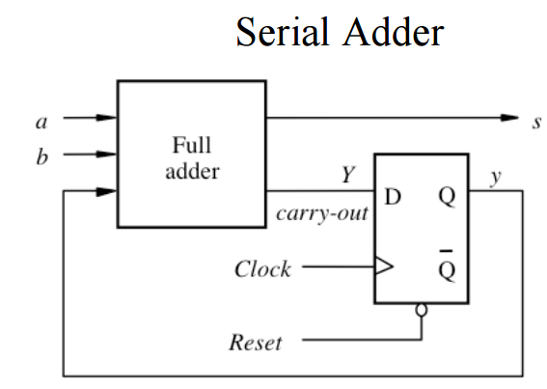
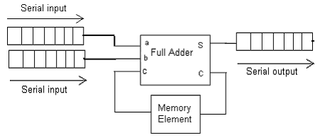

Slide 4
Multiplication
1. For unsigned/+tive integers
Sequential Circuit Binary Multiplier
(based on multiplication by hand)
1101---M (Multiplicand) (+13) 4bit
1011---Q (Multiplier) (+11) x 4bit
1101 1101x2⁰ x1 8 bits at most
1101 1101x2¹ x1
0000 1101x2² x 0
11 01___ 1101x2³ x 1
10001111 (143)

Slide 5
4bit x4bit multiplication need 4bit adder repeat addshift /shift 4 times
C |  | 1101 | M | Q |  | Initial State | 13
0 |  | 0000 | A | 1011 |  |  | 11
0 |  | 1101 |  |  | Add M | Cycle 1
0 |  | 1101 |  | 1011
0 |  | 0110 |  | 1101 | Shift
0 |  | 1101 |  | 1101 | Add | Cycle 2
1 |  | 0011 |  | 1101
0 |  | 1001 |  | 1110 | Shift
0 |  | 0100 |  | 1111 | Shift | Cycle 3
0 |  | 1101 |  | 1111 | Add M | Cycle 4
1 |  | 0001 |  | 1111
0 |  | 1000 |  | 1111 | Shift |  | 143

Slide 6
Register Configuration Sequential Circuit
C
an-1 | ……… | a0
qn-1 | …….. | q0
Register A Q
Control
Sequencer
n bit adder
MUX
Add/NoAdd
Control
0
mn-1 | …………… | m0
Multiplicand

Slide 7
Multiplication
2. For signed number in 2’s complement
Booth Algorithm
Facts used in this algorithm
Q=001110 = 2³ + 2² + 2¹ = +14 = 2⁴- 2¹
M x Q = M x 2⁴ - M x 2
M (Multiplicand) 4bit
Q (Multiplier) x 4bit
8 bits product
4 cycles to finish calculation
Sign extension needed to keep track of sign

Slide 8
Booth’s Algorithm M x Q = 7 x 3
A | Q | Q₋₁ | M | -M | Initial State | 7
0000 | 0011 | 0 | 0111 | 1001 |  | 3
1001 | 0011 | 0 | A-M |  | Cycle 1
1001 | 0011 | 0
1100 | 1001 | 1 | Arithmetic RightShift
1110 | 0100 | 1 | ARS |  | Cycle 2
0111 | 0100 | 1 | A+M |  | Cycle 3
0101 0010 | 0100 1010 | 1 0 | ARS
0001 Prod | 0101 uct | 0 | ARS |  | Cycle 4 | 21

Slide 9
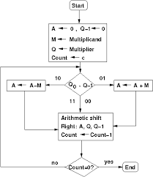
Flowchart of Multiplication using Booth’s Algorithm

Slide 10
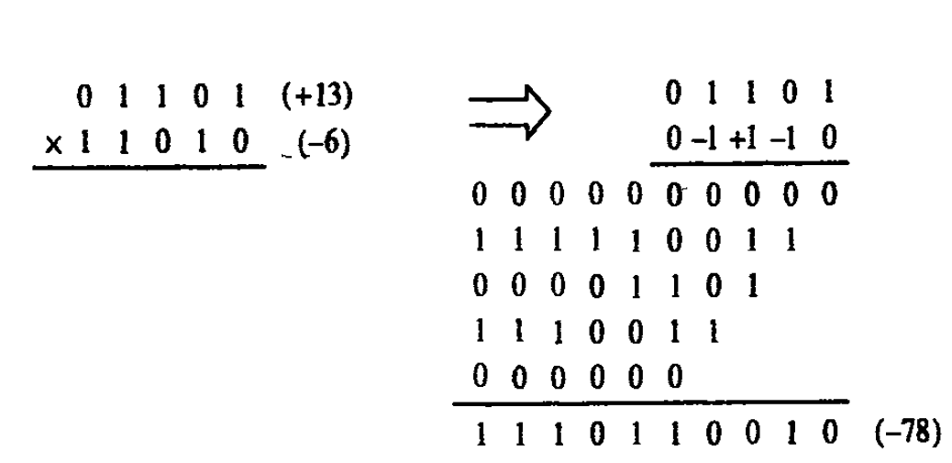
Multiplication (13 x -6) using Booth’s Algorithm

Slide 11
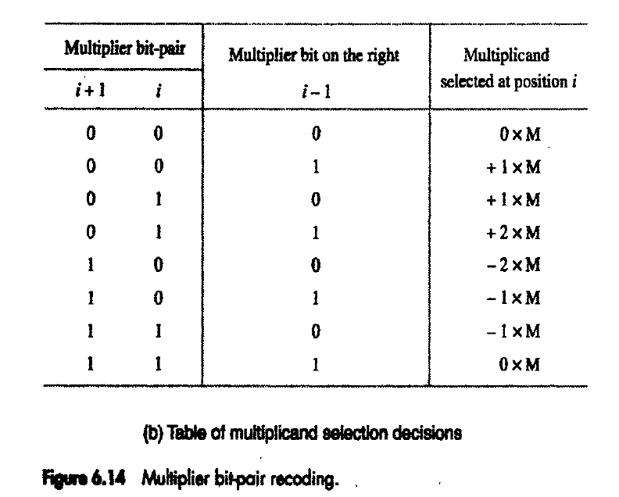

Slide 12
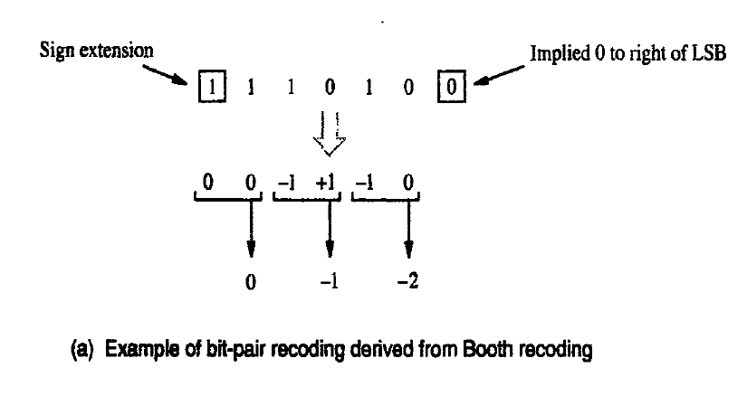
Bit-pair Recoding of (-6) using Booth Recoding

Slide 13
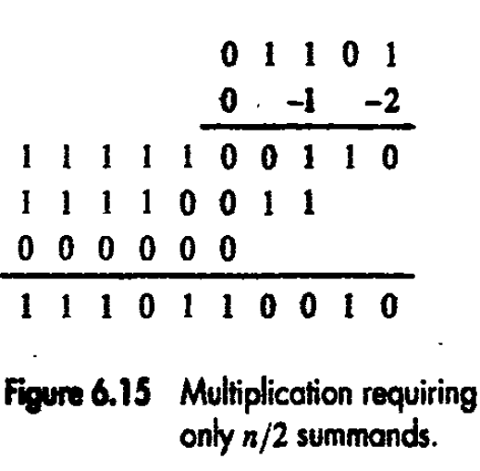
Multiplication (13 x -6) using bit-pair recoding of Multipliers using Booth Recoding
M
Q
Left shift M,Take 2’s Compliment
Take 2’s Compliment of M

